Slide 1
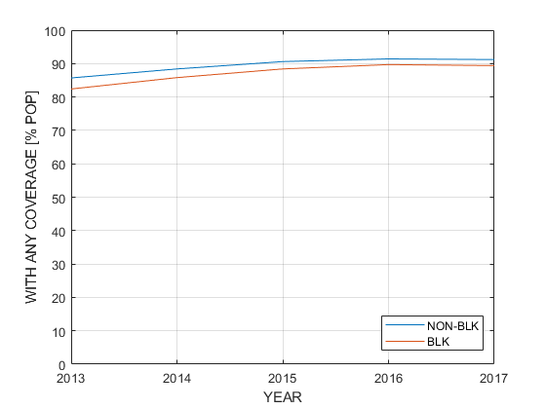
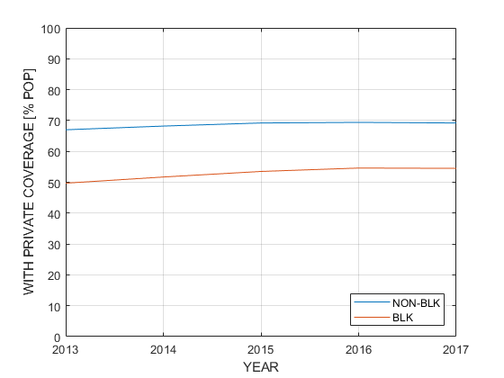
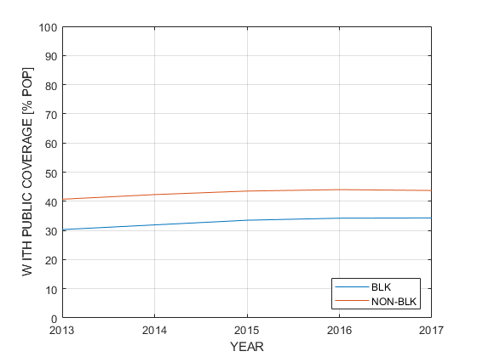
Nationwide public and private health insurance coverage over time cross-tabulated by race
Source: US Census Bureau’s American Community Survey 2013-2017 PUMS Files
Accessed via DataFerrett (https://dataferrett.census.gov/LaunchDFA.html?#)

